Slide 1
L4_5 Group 9
Thomas McCarthy (Designer)
Jayden Murray (Designer)
Cristian Hanganu (Programmer)

Slide 2
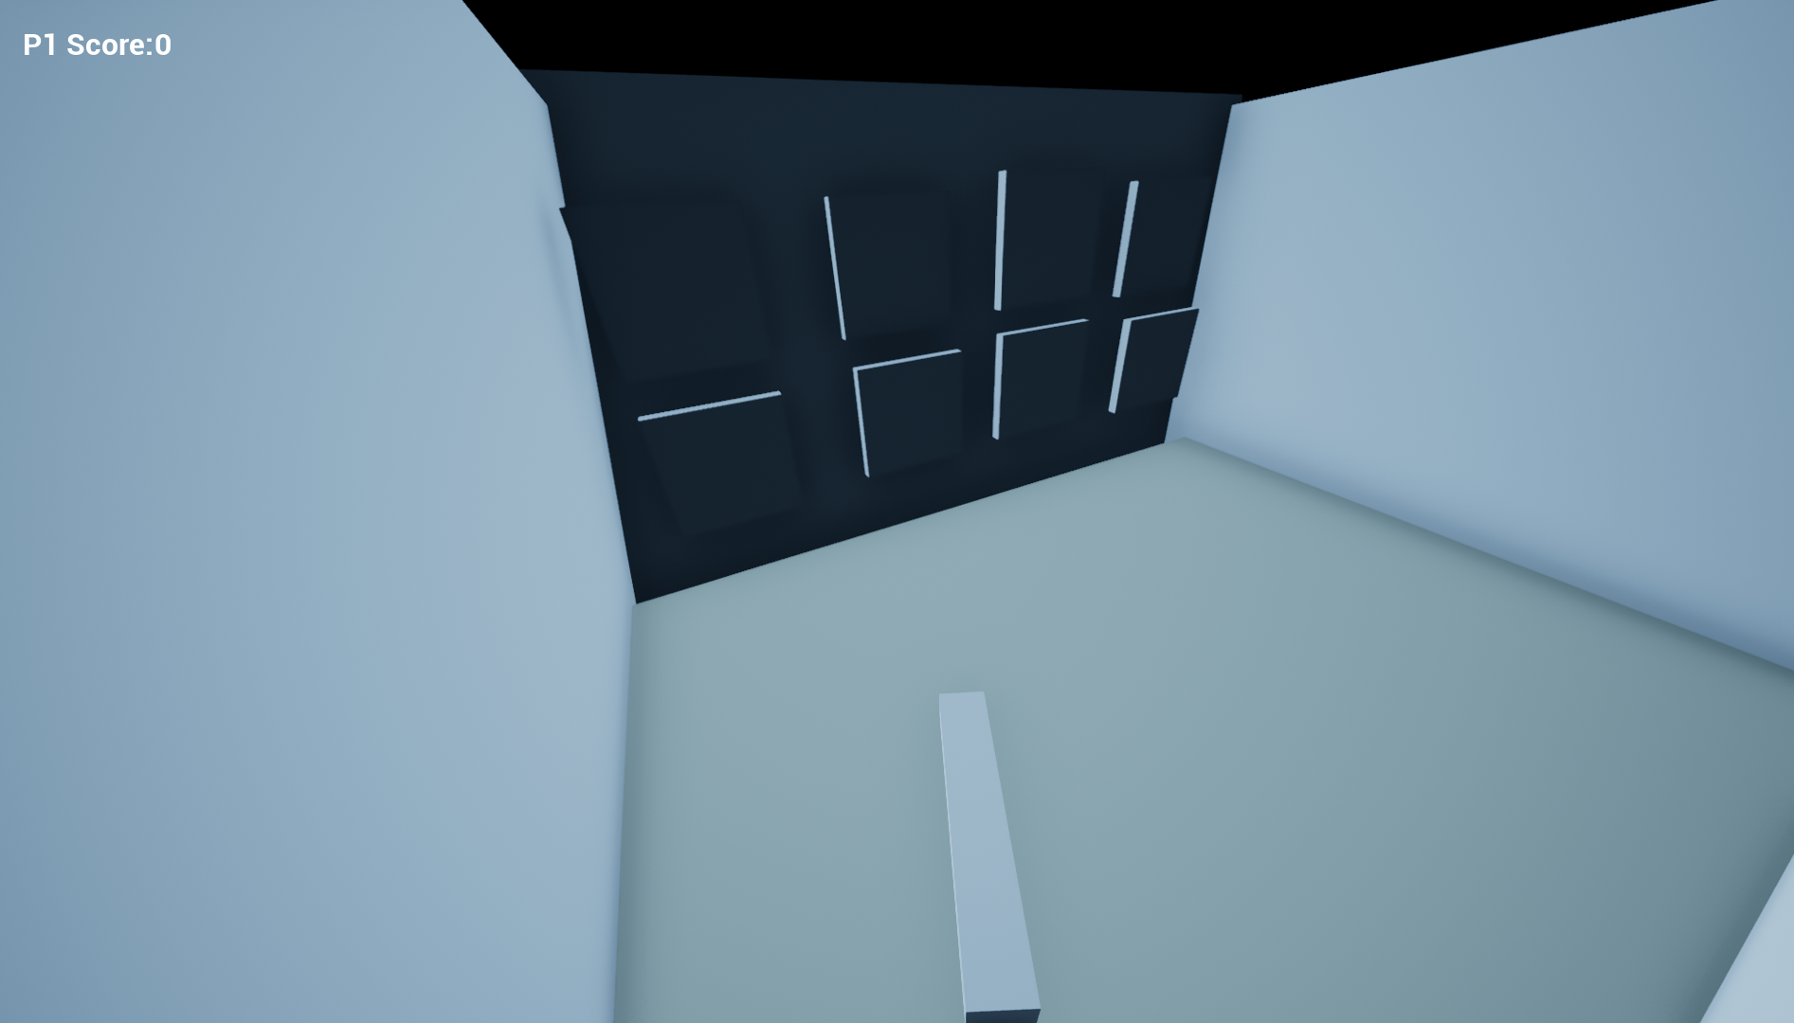
Previous Version

Slide 3
Feedback
What feedback we got and what we changed using that feedback
The game should not be in 3D.
This iteration does not meet the brief in any aspect.
The game should

Slide 4
Current Version
Insert Video

Slide 5
Feedback
Many people said they did not understand what is happening and what players need to do.
There is no win condition and players do not know who wins after all the windows are destroyed, due to the game closing straight away.
A lot of play testers were confused as why the buildings are not in frame.
There are many bugs.

Slide 6
Next 2 Weeks
What we hope to achieve in the next two weeks

